Slide 1
Reading a scientific paper
I know it looks intimidating, but you can do it!
Notes:
How is everyone feeling?

Slide 2
How did you feel reading the paper? What was difficult? What helped you understand?

Slide 3
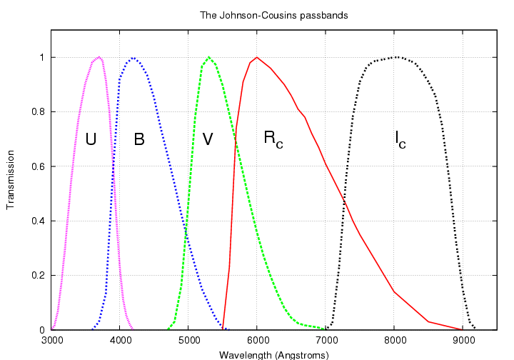
Color in astronomy: young things are blue (U/B), old things are red (V/R/I)
Source: https://www.researchgate.net/figure/3-UBVRcIc-Johnson-Cousins-Filters-Johnson-Cousins-UBVRI-filter-curves_fig3_326412740

Slide 4
The scope of “the problem”
What’s going on in the green valley?
The mechanics of quenching
Maybe Black Holes?

Slide 5
One of the best questions to ask yourself is: “Why does this paper exist?”
What is the story that the paper is trying to tell?
  What is the problem they’re trying to solve? What new information or approach do they have to solve or understand something?
What is the context of this paper?
  Who is writing it? Who are they building off of or responding to?
Who should read it?

Slide 6
Another question to ask yourself is: “What did this paper do?”
What is the key trend the paper found when it comes to stellar formation rates in galaxies?
  What data did they use to find this trend?
Why do they believe in this trend?

Slide 7
Another question to ask yourself is: “What does this paper think?”
Which of the mechanisms for explaining galaxy quiescence do the authors seem to favor?
  What is the evidence?
What is the paper’s final conclusion on all this green valley stuff?

